Slide 1
Organisation
Start time: 8.45am
End time: 3.15pm
All children can enter the classroom as they arrive through the main gate. Children will have an early morning activity ready for them as they prepare for the school day. All children will leave school at 3.15pm. Please ensure children arrive on time and the office is informed of any absence by 9am.
PE Days
PE days are Wednesday and Friday and children should come in to school wearing their PE kit.
Autumn Term 2022
Daily Reading
It is important that you try to hear your child read every day for at least 5-10 minutes. You could also read a story to your them so that they are exposed to a range of vocabulary.
Reading continues to be a high priority for all children and they will be taught how to deduce, infer or interpret information, events or ideas from a text. Children should be encouraged to read different genres and answer questions on accelerated reader.
I hope you all had a restful Summer break and welcome to our autumn term
It has been wonderful to welcome all the children back to school. We hope you had an enjoyable summer break. We are looking forward to being part of your child’s learning this year. Mrs Calvert, who is the new teaching assistant, in Oak Class can’t wait to be part of your child’s journey and will work with the children for four days.
Mrs Okoturo
Oak class teacher
Homework
Homework will be set every Friday, and should be returned to school by the following Tuesday. Children are encouraged to complete as much as they can in a reasonable amount of time for your child.
Homework will focus on the learning completed in school that week, to consolidate what has been taught in English, Maths and the foundation subjects. Children in will be set weekly spellings to support vocabulary building.
Nature Explorers
At some time in the year, every child in Oak Class will take part/enjoy nature explorer sessions with Mrs Foot. During these sessions pupils will use the outdoors to learn about the environment, plants and nature.

Slide 2
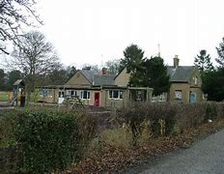
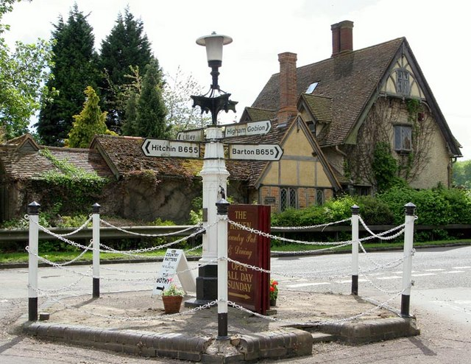
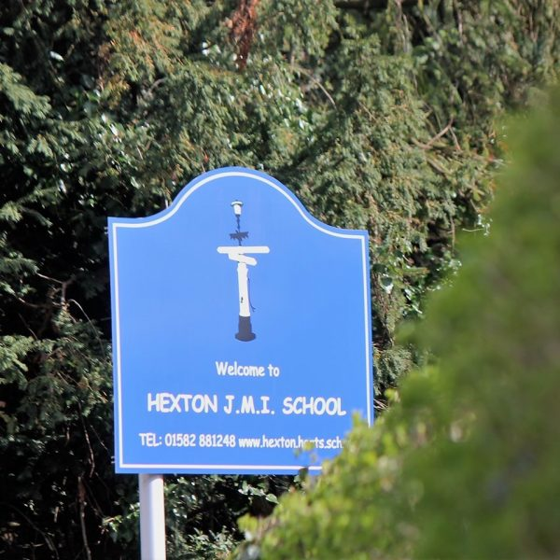
English
Traditional fables : War and Peas by Michael Foreman
The children will be taught how to identify and understand meanings of a wide range of conjunctions used to link events together. They will recognise different narrative genres and learn how to suggests reasons for actions and events.
Historical Fiction: War Horse by Michael Morpurgo
The children will read and summarise a chapter, revise clauses and conjunctions and explore on single-clause sentences for action scenes.
Maths
Children will be taught place value which will include counting in multiples of 10, 100, 1000, Roman numerals, identifying, representing and estimating and rounding to the nearest 10, 100 and 1000. The children will be taught to read, write, order and compare numbers.
Children will be taught to add, subtract, multiply and divide (mentally and written) to solve problems.
Science
Rocks(Year 3/4)
Children will compare and describe different types of rocks. They will also describe how fossils are formed and have a go at making their own fossils. They will recognise that soils are made from rocks and organic matter.
Earth and Space (Year 5/6)
Children will understand about the relative movement, shapes and sizes of the earth, sun and moon. They will also learn about the rest of the solar system and human’s exploration of space.
Curriculum Newsletter
Oak Class
Innovation
In Computing, the children will be learning all about coding. They will use simplify code to make their programming more efficient. They will use variables in their code and create a simple playable game.
In DT, children will learn to design and develop a program house and promote a Micro: bit electronic charm to use in low light conditions.
Humanities
In History, children will learn about the Mayans. They will explore where and when the remains of the Mayan civilisation were discovered. The children will find out about the city states of Maya and society was organised.
In RE, children will find out about the different beliefs of religious and non religious communities in our local area. They will consider the ways in which belonging to a religious community can help people.
Wellbeing
In PSHE, we will be looking at
Health and Wellbeing and how Positive Thinking can influence our choices.
In PE, we will be developing skills in games, dance and gymnastics with extra sessions linked to class learning with Stevenage Borough FC.
The Arts
In Music, children will be following the Charanga music scheme. There will be new topics each term throughout the year.
In French, children will use their detective skills to spot cognates and will learn new transport-related vocabulary and construct sentences using parts of the verb –aller-to go and prepositions to express going on holiday to a different country.
In Art, children will design a Maya mask which were used to decorate the temple.

